Slide 1

Password Security System

Slide 2
PRESENTER
Course Name : Digital Logic And Circuits Lab
Course Instructor : NUZAT NUARY ALAM
Section: L
Group: 7
ID | NAME
22-47000-1 | LIDA KHAN MUKTI
22-47010-1 | MD. JAHID HASAN
22-47018-1 | FARJANA YESMIN OPI
22-47019-1 | MD. ABU TOWSIF
22-47047-1 | NAZIM-E-ALAM

Slide 3
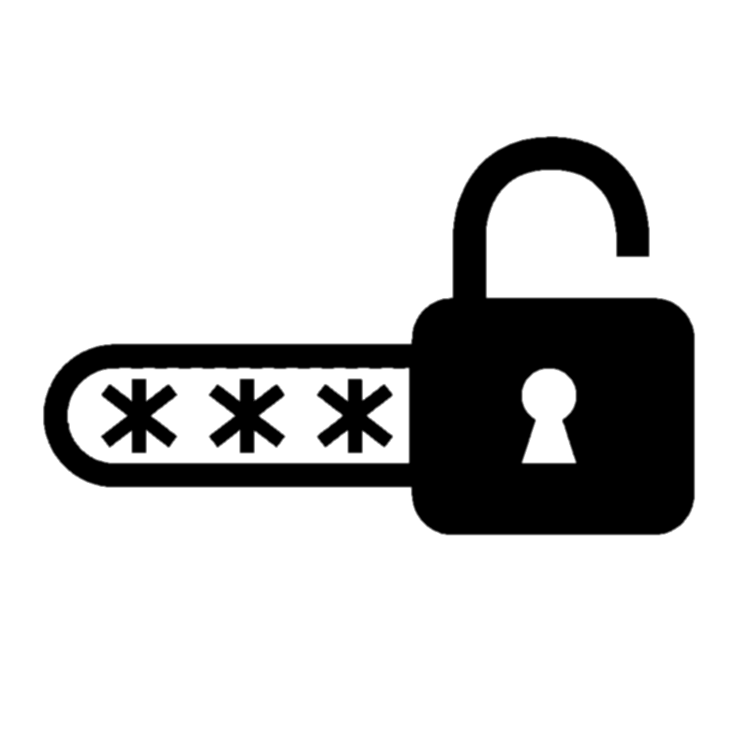
TABLE OF CONTENTS
1
Introduction
7
Limitations
2
Objective
8
Simulation
3
Methodology
9
Hardware
4
Component
10
Future Scopes
5
Circuit Diagram
11
Discussion
6
Working Principle
12
Conclusion

Slide 4
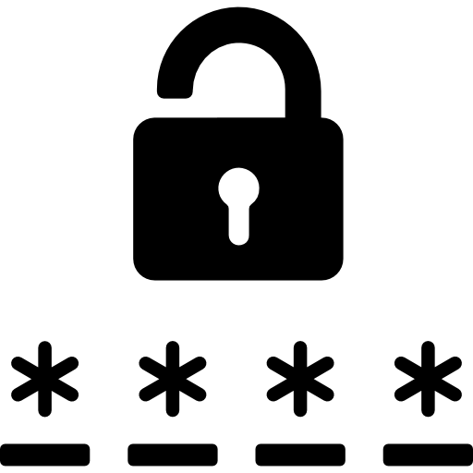
01
INTRODUCTION
The use of logic gates is critical to industries worldwide. In today’s world, copious individuals’ input password into his/her security system to secure or to unsecure his/her home and/or business. In this project, we harness the power of basic logic gates—AND, NOT, and XOR—to fortify password protection systems. With cyber threats on the rise, our objective is to design an innovative and secure authentication system. We explore the binary nature of data representation, strategically arranging logic gates to create a multi-layered security architecture. Through the construction of a prototype circuit, we showcase the synergy between digital logic and cybersecurity.

Slide 5
OBJECTIVE
02
The primary objective of this project is to explore and implement advanced password security mechanisms using basic logic gates in the context of digital logic and circuits. In response to the escalating threat landscape of cyberattacks and unauthorized access, the project seeks to develop an innovative password protection system. The goal is to leverage fundamental logic gates such as AND, NOT, and XOR gates to create a sophisticated and multi-layered security architecture. The project involves the construction of a prototype circuit where each logic gate plays a pivotal role in shaping the overall security landscape. Through simulations and practical experimentation, the project aims to assess the reliability and efficiency of the designed system, ensuring that it is both resilient and user-friendly. Ultimately, this project strives to highlight the intersection of digital logic and cybersecurity, showcasing how the integration of electronic principles can significantly strengthen the foundations of digital security.

Slide 6
METHODOLOGY
03
The methodology of this project involves a comprehensive exploration of advanced password security mechanisms within the domain of digital logic and circuits . This represents a passcode based security system having the provision to change the passcode by the authority only, using XOR Gates as bit comparators and NOR Gates as controlled inverters. This proposed system will provide a user friendly security system for user. If the passcode entered is right, it is indicated by a LED. Any wrong attempt (by entering the wrong password), an alert will be actuated, indicated by another LED. When an input passcode is given, based on whether it is correct or incorrect, green or red LED glows. If the red LED glows, it’s an indication of incorrect passcode.

Slide 7

04
Components
1
2
3
4
XOR Gate
NOT Gate
AND Gate
LED
5
6
7
8
Breadboard
Wire
DIP Switch
Power Source

Slide 8

05
Circuit Diagram

Slide 9
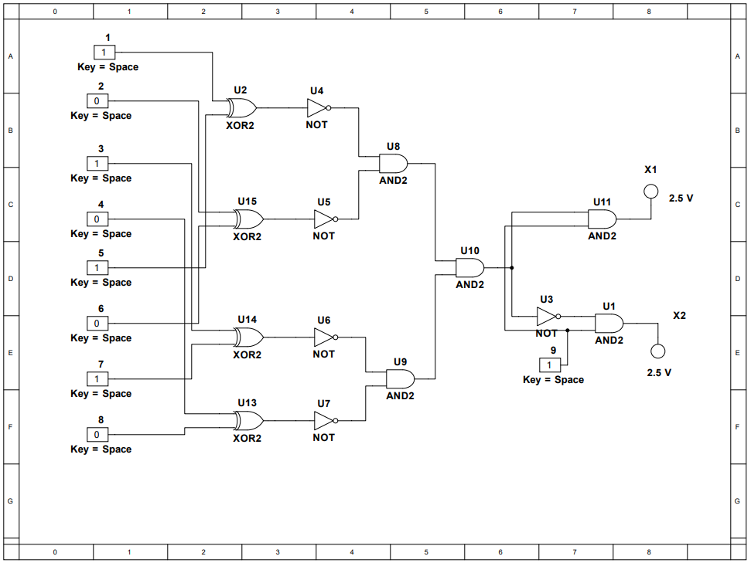

Slide 10

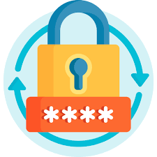
Working Principle
06

Slide 12
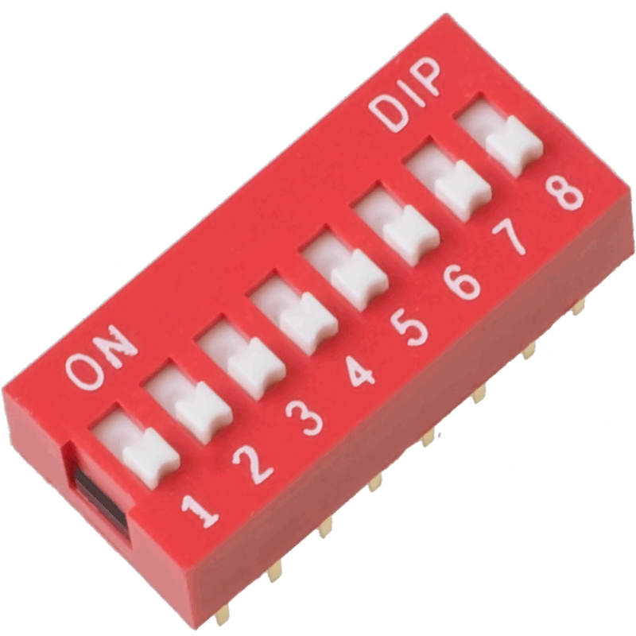
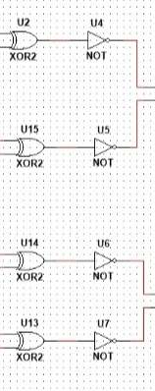
Utilize DIP switches to set a binary password.
Directly store the password within the circuit.
Enter the password using DIP switches.
Translate DIP switch positions to binary for comparison.
Each XOR gate compares corresponding bits of entered and stored passwords.
Invert XOR gate outputs for matching and mismatching bits.

Slide 13
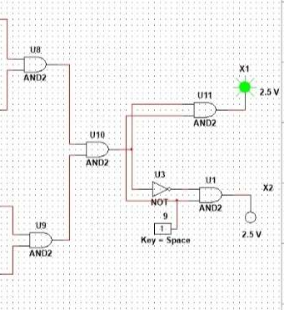
AND gate Receives inverted outputs from NOT gates.
Green Led Illuminates for a correct password (AND gate high).
Red Led Illuminates for an incorrect password (AND gate low).
Power Switch Separate switch to activate or deactivate the entire circuit.
LEDs and logic gates remain inactive when off.

Slide 14

Limitation
07

Slide 15

1. Password Complexity Constraints:
DIP switches restrict password length, limiting complexity compared to software solutions.
2. Physical Vulnerability:
The circuit is susceptible to tampering or damage, potentially compromising security.
3. Lack of Scalability:
Modifying password length or adding features requires redesigning and rebuilding the circuit.
4. Bulkiness and Portability Issues:
Breadboard setups are not portable and can be bulky, limiting practical applications.

Slide 16

5. Power Consumption Concerns:
LEDs and logic gates consume significant power, often requiring external power sources.
6. Limited User Friendliness:
DIP switches are less convenient for password entry compared to digital keyboards.
7. Susceptibility to Noise:
External electrical noise can interfere with signal transmission, potentially causing malfunctions.
LED responses offer minimal error information; advanced detection requires additional circuitry.
Circuit construction with reliable components and security features can increase costs.

Slide 17
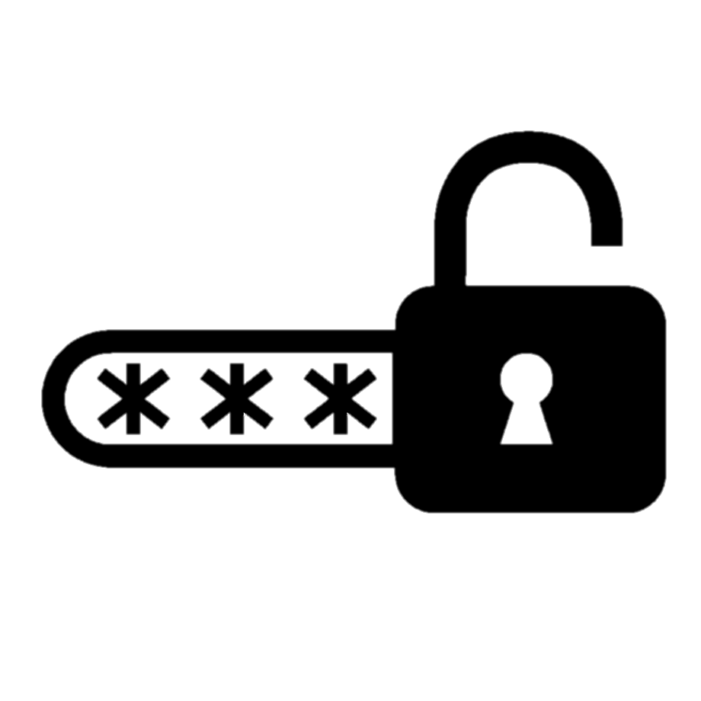
Simulation
08

Slide 18
Hardware Demonstration
09

Slide 19
10
Discussion

Slide 20


The presentation underscores the imperative for innovative approaches to cybersecurity due to the evolving threats faced by traditional software passwords.
Acknowledging vulnerabilities, the proposal introduces a hardware-based system with tangible security benefits and educational value.
Users set their secret codes using physical DIP switches, engaging logic gate guardians, such as XOR and AND gates, for verification.
LED feedback offers a green glow for success and a red alert for incorrect attempts. While boasting offline resistance to digital hacking, the system does face limitations like password complexity constraints and physical vulnerability.

Slide 21
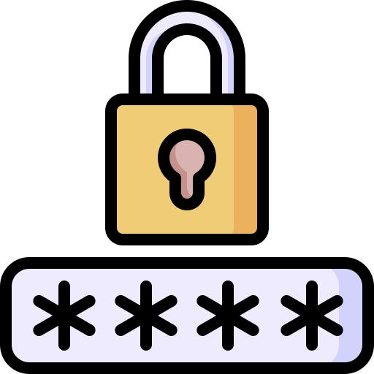
The presentation suggests future enhancements, including increased complexity with additional logic gates, exploration of remote access through wireless interfaces, and integration of advanced features like error detection and user authentication protocols.
Ultimately, hardware password systems are positioned as valuable learning tools and security solutions, with the call to address limitations and encourage ongoing exploration of hardware-based cybersecurity approaches.

Slide 22
11
Future Scope

Slide 23

Deepen Security:
Explore layered authentication by adding biometrics, encryption, and tamper detection mechanisms.
2.Embrace Remote Access:
Integrate wireless communication for password management and system monitoring from afar.
3.User Experience Matters:
Design a dedicated interface for convenient password entry and system interaction.

Slide 24

4.Go Mobile and Modular:
Develop compact and scalable circuit arrangements for portability and flexibility.
5.Think Advanced Features:
Experiment with dynamic passwords, self-destruct mechanisms, and network integration.
6.Keep Evolving:
Stay updated on new technologies and security protocols to continuously improve your system.

Slide 25
12
Conclusion

Slide 26

This project showcased the power of digital logic, crafting a tangible fortress of security from gates and LEDs.
We delved beyond mere protection, illuminating the learning potential hidden within circuits and code.
We acknowledged the project's boundaries, but instead of seeing them as roadblocks, we embraced them as stepping stones for future innovation.
By building and testing, we planted the seeds of invention, inspiring continued exploration in hardware-based security solutions.
The melody of logic plays on, urging us to compose new symphonies of protection in the ever-evolving digital landscape.

Slide 27

THANK YOU!

